Slide 1

Celebrating Lifelong Health & Wellness
General SHAC Meeting
Wednesday, December 6, 2023

Slide 2


Welcome & Mindful Moment
Allison Thummel
FBISD SHAC Chair

Slide 3

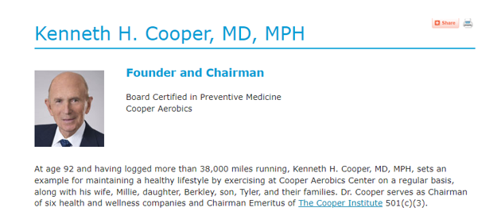

Slide 4
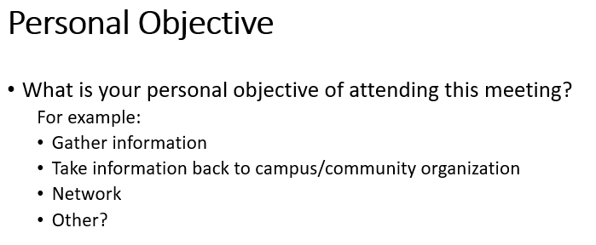
Personal Objective of Meeting

Slide 5
SHARED DREAMS: SHAC Support: 12/6
Shared Dreams provides temporary support to registered students in need who have been designated by school staff. There is a high need for food items:
Canned chicken
Peanut butter (plastic containers)
Jelly (plastic containers)
Breakfast bars or individually wrapped snacks (i.e., pretzels, cheese crackers)
Canned fruit
Donate funds to Shared Dreams so purchases can be made as needs arise: bit.ly/3E6WYU2

Slide 6
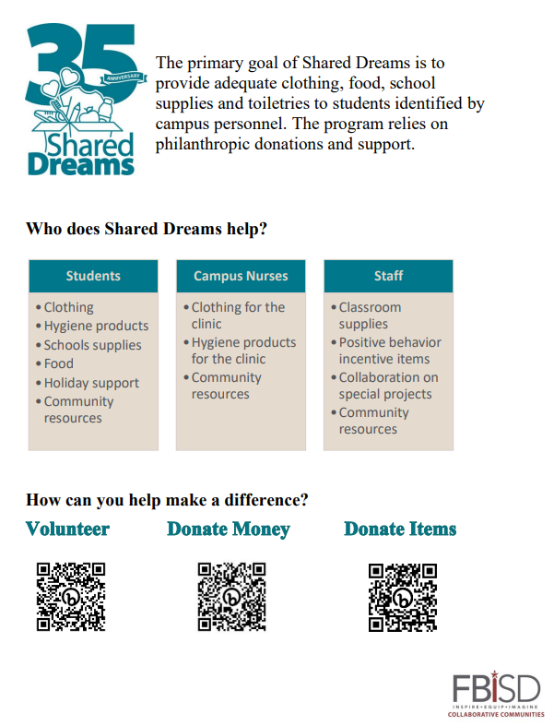
Celebrating Shared Dreams
Notes:
(Can you please embed Payal’s video here?)

Slide 7

Celebrating Shared Dreams Video

Slide 8
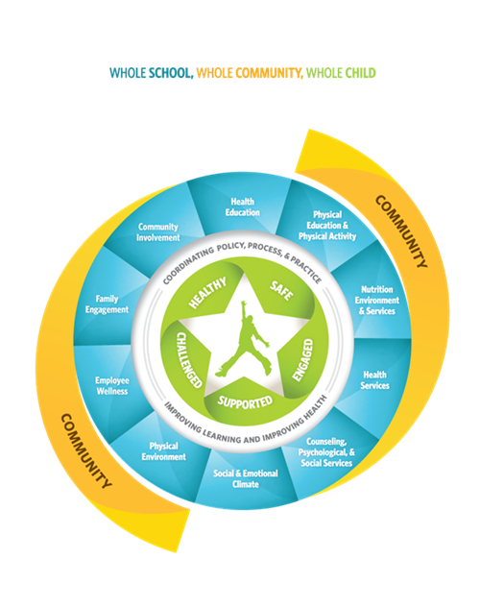
Introductions
New SHAC Members
Holly Stojanik: Dairy MAX
Nichole Brathwait-Dingle, MD: FB County Health Dept.
Shell McClue (Student @ Burleson ES, Heritage Rose ES, Elkins HS)
Tempest Bui: Parent (Student @ Oyster Creek ES)
Derek Craig, PhD: UT Health Houston

Slide 9
The Truth About Tobacco and Vaping: What Preteens Should Know
Jeanette Lastrape
MD Anderson Community Relations Manager

Slide 10
What Is Crime Stoppers?
Ernesto Reyes
Crime Stoppers
Statewide Safe School Institute Manager

Slide 11

What is Crime Stoppers?
Crime Stoppers Tip Line Presentation
Ernesto Reyes
Crime Stoppers
Statewide Safe School Institute Manager

Slide 12

Vote: Minutes from October 18, 2023
Jenna Ross
SHAC Secretary

Slide 13
Brain Break
Rebecca Matthew & Winston Rodriguez Ridge Point HS

Slide 14

We’re looking for a few good men (& women)
SHAC Vice Chair (or Co-VC)
SHAC Secretary
SHAC Membership Chair
SHAC Advocacy Parent Lead
SHAC Communications Chair

Slide 15

We’re looking for a few good men (& women)
  FBISD Wellness Policy Updates-Contact Lori Sartain
  Advocacy: SHAC Legislative Priorities-Contact Rocaille Roberts

Slide 16
Think Tank
Angela Espinosa
Social & Emotional Learning Coordinator

Slide 17

Think Tank

Slide 18

Think Tank

Slide 19

Think Tank

Slide 20
Upcoming Events & Updates
LaDonna Green
FBISD Wellness, Health & Prevention Specialist

Slide 21


Slide 22


Slide 23

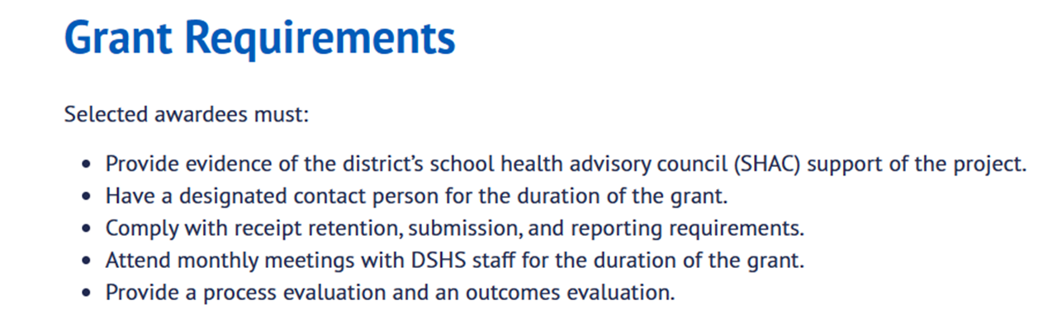
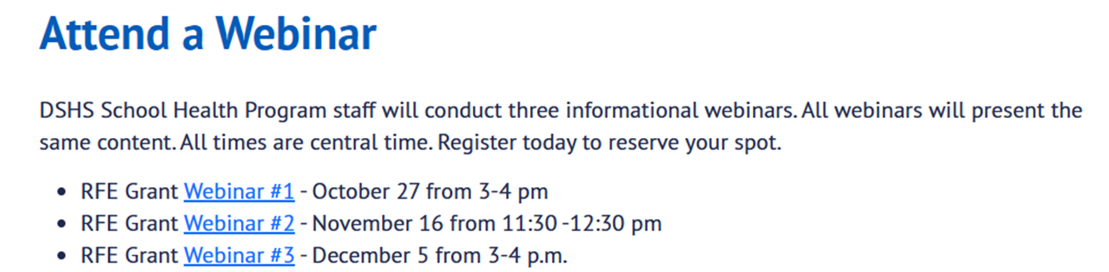

Slide 24


Slide 25

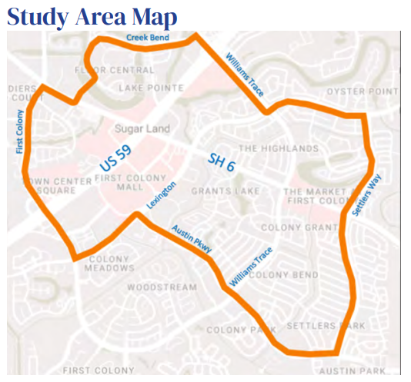
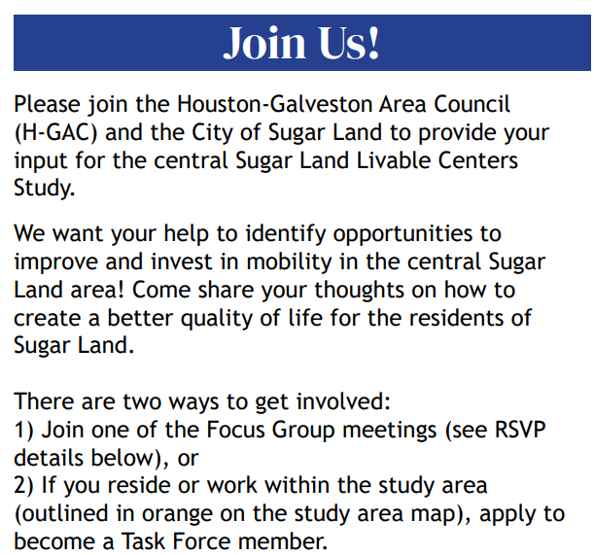

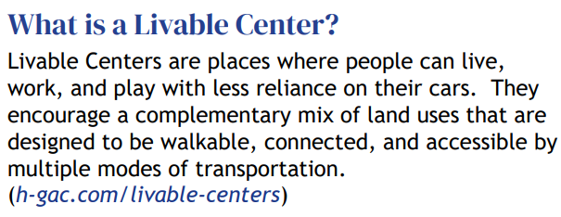
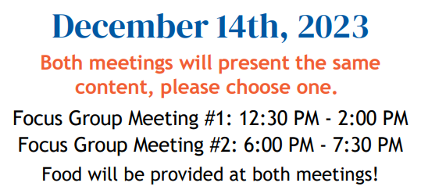
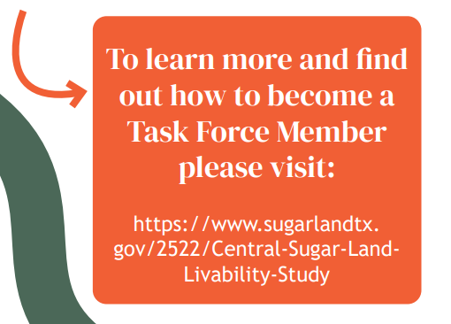
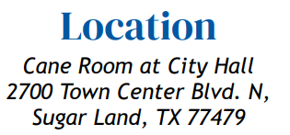
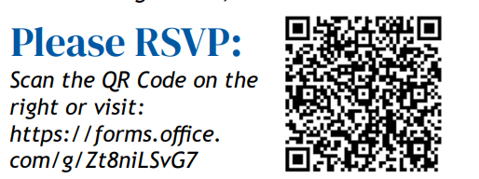
Upcoming Events

Slide 26
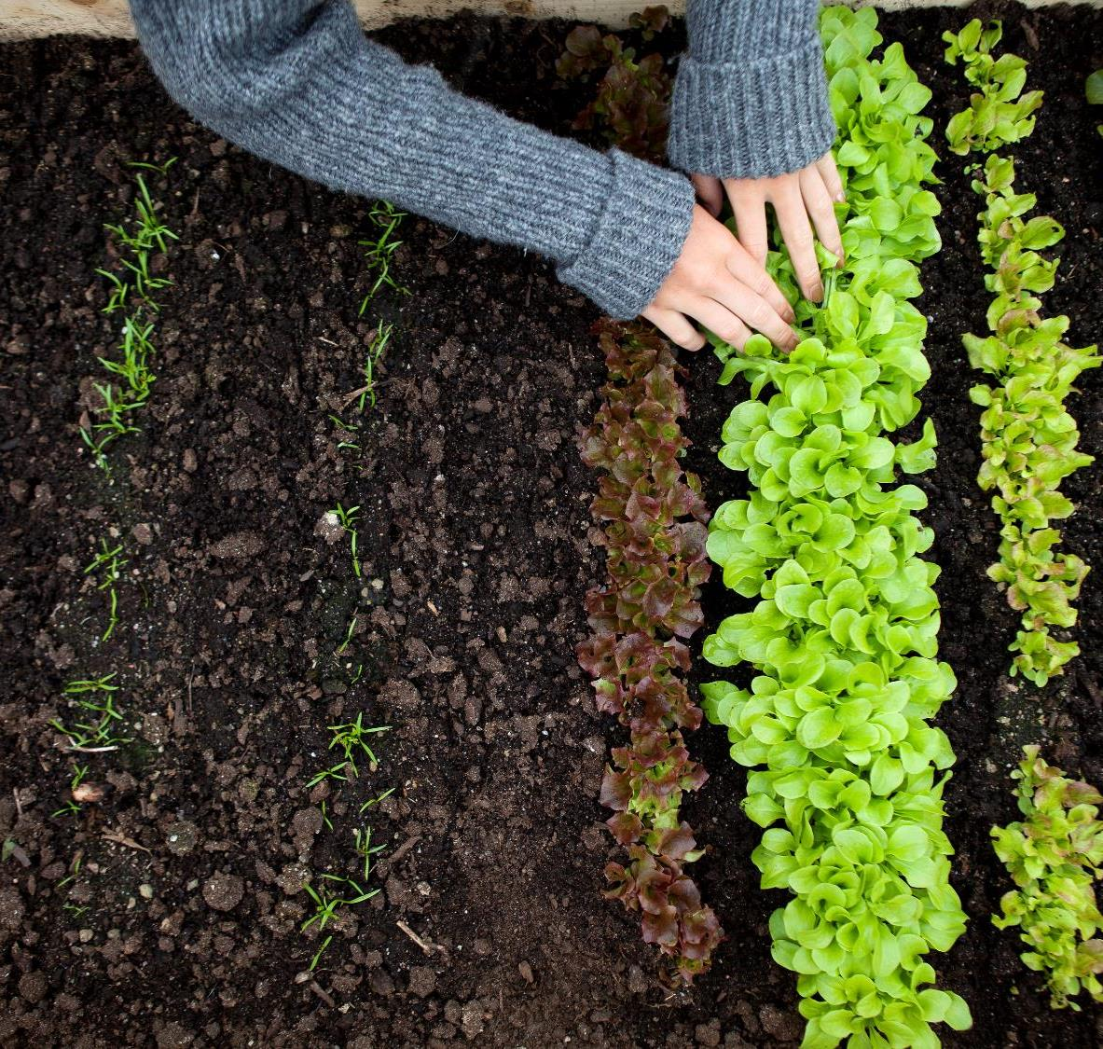





Fall Accomplishments 2023
Nutrition Subcommittee
Farm Fresh Month – October
Bringing more fresh nutritious foods into schools
Completed TDA’s farm fresh challenge: Eat local, Teach local, Be Social.
Harvest of the Month
Served and promoted October Harvest- Gala Apples
29th Annual Food Fair and Tasting- Harvest Fest
Featured hundreds of approved food items to taste and provide feedback for next years menus.
National School Lunch Week
Oct 9th-11th
Oct 11th- Bring your parents to lunch day
Holiday Meals
Nov. 16th – Families invited to enjoy a special holiday meal during lunch at students' campus

Slide 27
Subcommittee Convene
Health & PE, Whole Child Health, Advocacy, Campus Safety, & Nutrition

Slide 28

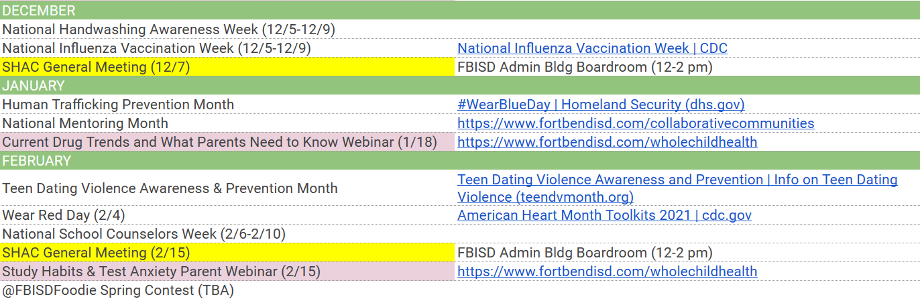
Liaison & SWC Action Items
Take back to campus info from MDA& Crime Stoppers
Look into/apply for grant
Participate in Character Poster Contest (students only)
Try new salad
Participate in Advocacy/LP or Wellness Policy review
Watch “Stress & Anxiety” Webinar on Jan 17
7) Promote upcoming health initiatives:

Slide 29

Meeting Closure
Next General SHAC Meeting
February 28, 2024
Fort Bend ISD Administration Building
16431 Lexington Blvd
Sugar Land, TX 77479
12:00 p.m. – 2:00 p.m.

Slide 30

FORT BEND ISD
16431 Lexington Blvd.
Sugar Land, TX 77479
281-634-1000
www.fortbendisd.com

